Slide 1

Predicting personality through the Big Five using data mining concepts
by Chengpeng Wu
CSc 4740/6740 Data Mining
Instructor: Dr. Yanqing Zhang

Slide 2

INTRODUCTION
CHARACTERISTICS AND PERSONALITY
Five characteristics of different individuals commonly known as big five characteristics namely, openness, neuroticism, conscientiousness, agreeableness and extraversion.
However, the big five characteristics are also affecting the five different personalities: Extraverted, Serious, Responsible, Lively and Dependable
This project uses learning algorithms and advanced data mining concepts to mine user characteristics data and learn from the patterns.

Slide 3

from train dataset to model
Let’s Dive In

Slide 4
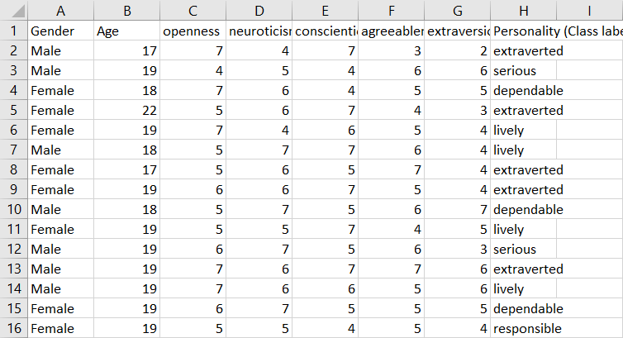
First 16 sample persons
Dataset is collected from the Kaggle https://www.kaggle.com/tunguz/big-five-personality-test
There are two different Datasets at this project: one would be train dataset which contains total 710 persons of Big Five test result and their identified personality for model training. The other one would be test dataset that are used for model predicting.
Test dataset also contains labeled personality for accuracy checking.

Slide 5
Data Type
S.No | Attribute | Type | Range
1 | Gender | Nominal | Male/Female
2 | Age | Numeric | 17-28
3 | Openness | Numeric | 1-8
4 | Neuroticism | Numeric | 1-8
5 | Conscientiousness | Numeric | 1-8
6 | Agreeableness | Numeric | 1-8
7 | extraversion | Numeric | 1-8

Slide 6
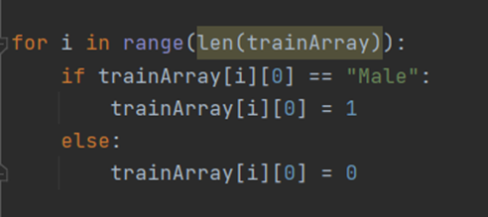
Data preprocessing
DATA TYPE CONSISTENCY
Since most of the data type are numeric in the dataset, I decided to just convert the gender part to numeric and let 0 represent “male”, 1 represent “female ”.
Converting the nominal attributes(gender) to numeric value. Code is shown in the left.
S.No | Attribute | Type | Range
1 | Gender | Numeric | 0-1

Slide 7
Big Five and Mo
IN ORDER TO ANALYSE AND CLASSIFY PERSONALITIES OF A GIVEN SET OF PEOPLE OR AN INDIVIDUAL, IDENTIFIED THE BIG FIVE AND MODELING FROM IT WOULD BE VERY POWERFUL

Slide 8

The Big FIVE traits
OPENNESS
NEUROTICISM
CONSCIENTIOUSNESS
AGREEABLENESS
EXTRAVERSION

Slide 9
16 Persons From train Dataset

Slide 10

from Random forest to Linear model
Model choosing

Slide 11
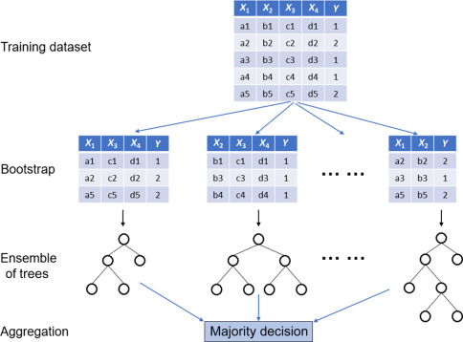
RANDOM FOREST

Slide 12
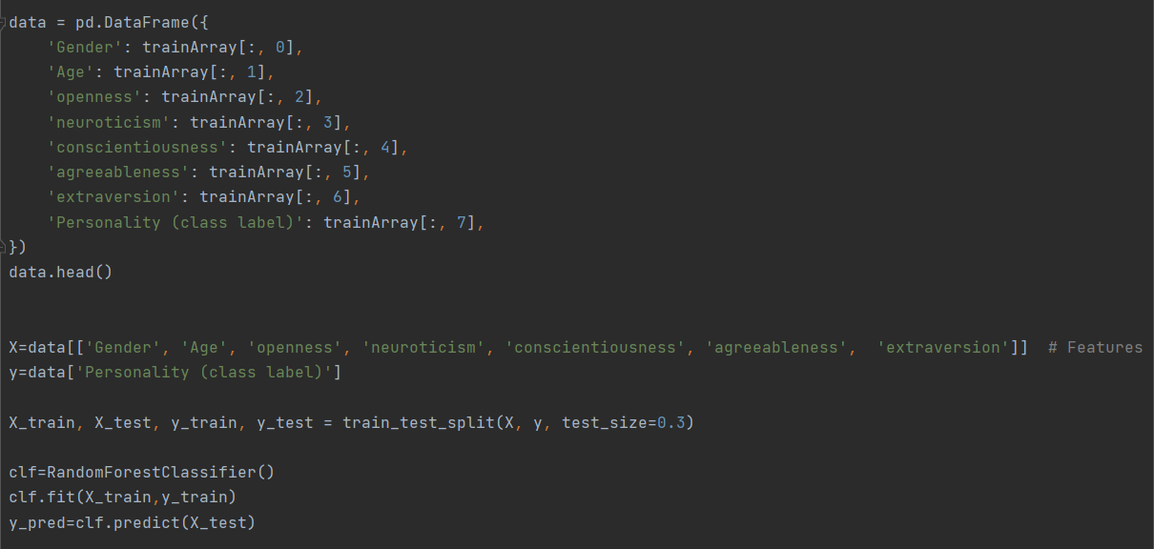
Source code
Random forest model

Slide 13
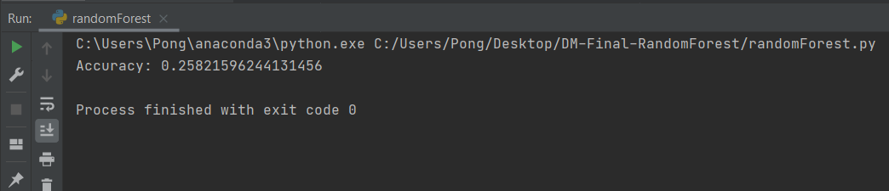
Accuracy unmet
However, the result wasn’t quite satisfied.

Slide 14
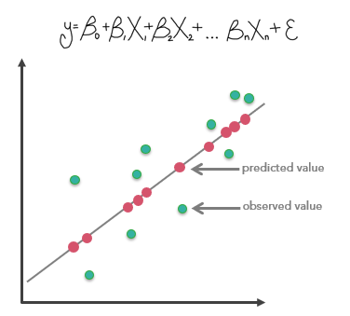

Linear model
LOGISTIC REGRESSION
Since the number of factors are multiple, and the result that we trying to predict is simply just one. The linear model would be the best fit at this point.
Main functional based is shown as below:

Slide 15
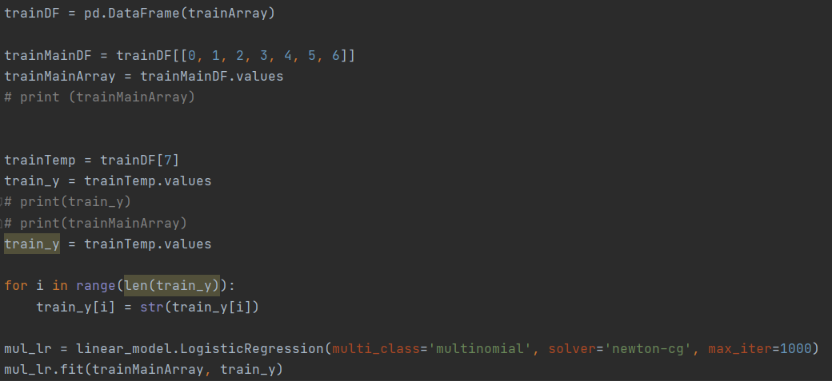
Source code
LOGISTIC REGRESSION

Slide 16
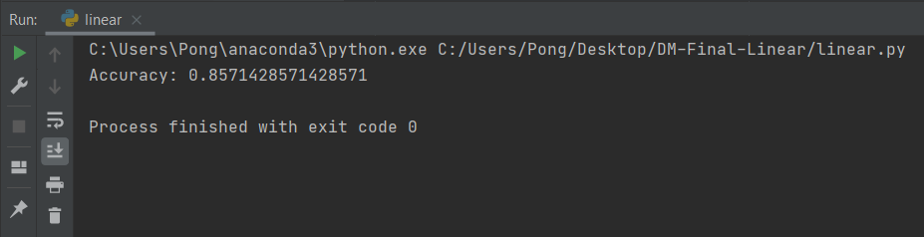
And this time, it worked!
Accuracy Met

Slide 17

SUMMARY
RANDOM FOREST WASN’T SATISFIED
The accuracy of random forest provided result is only .258
LINEAR MODEL - LOGISTIC REGRESSION IS SATISFIED
The accuracy of this model is providing the prediction with .85
LINEAR MODEL FITS BETTER IN LARGE AMOUNT DATASET WORKS
Under large amount dataset conditions, the linear model is more accurate and more efficient in predicting.

Slide 18



THANK YOU
Chengpeng Wu
+1 (646) 556-7020
cwu29@student.gsu.edu

